Slide 1

DOELAP External Dosimetry Training
Travel Topics
Idaho Falls, ID
September, 2026

Slide 2
Travel Contacts
Cameron Cook
  cookc@id.doe.gov
  (208) 479-3045
  1955 Fremont Ave.
  MS 1240
  Idaho Falls, ID 83415
Kira Jones
  joneskj@id.doe.gov
  (208) 851-5434

Slide 3
Funding for Assessor Travel
DOELAP reimburses travel expenditures that are considered customary and necessary for the completion of duties.
If you mix business and pleasure travel:
  you must get approval from STM and get a theoretical cost comparison
  Driving POV vs. flying: get a theoretical estimate of costs of flying vs driving, reimbursement for lesser of the two
  For travel outside the approved training travel dates: the traveler pays the difference between the theoretical DOELAP-only dates travel fare and the cost for the dates of personal travel, reimbursed for the lesser of the two. Traveler is placed on leave in Concur for additional dates outside approved training and travel dates.
  Traveler is also responsible for: extra hotel nights, fuel, etc.

Slide 4
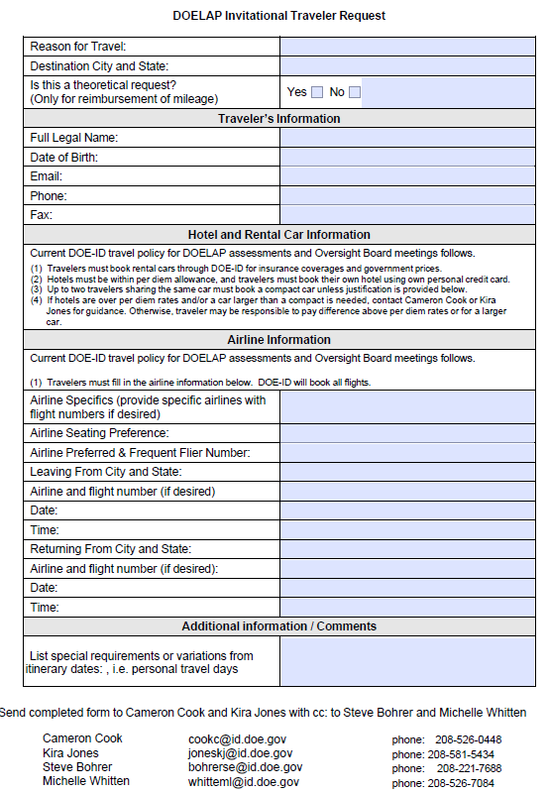

Slide 5
Travel Requests
Lead assessor coordinates with other assessors (and site if desired) to choose an appropriate hotel.
Travelers should make all efforts to get government per diem rate
  If government rate is unavailable, over per diem may be authorized
  Cameron and Kira need to have hotel price per night prior to completing the travel authorization (over per diem must be approved in advance)
Travelers are responsible to make their own hotel reservations
  Cameron/Kira make rental car and flight reservations
For transportation between home and airport: Identify taxi, uber, POV mileage (roundtrip), airport parking, etc.
The sooner the better

Slide 6
Rental Car/Local transportation
One car per team
Rental car typically is reserved under Lead Assessor’s name, but be sure to let Cameron/Kira know who should be assigned
Travelers must use the LEAST expensive compact car available
  If more than 2 assessors are going a larger car may be justified
Indicate assessment duration
Submit justification for rental car
  Basic justification (1 car per team, travel between hotel and site)
If possible, identify any known airport, hotel, or other parking fees that will be necessary

Slide 7
Rental Car/Local transportation
Save receipts for
  Rental car gas
  Shuttle to/from airport
  Taxi to/from airport
Travelers will NOT be reimbursed for purchasing pre-paid refueling options.
Travelers should refuel prior to returning an approved rental vehicle.
Taxi for meals is not reimbursable

Slide 8
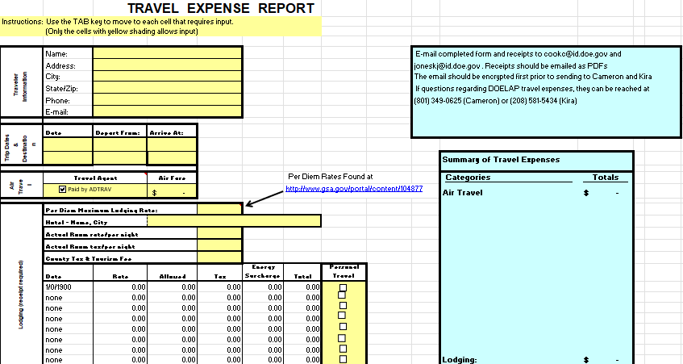
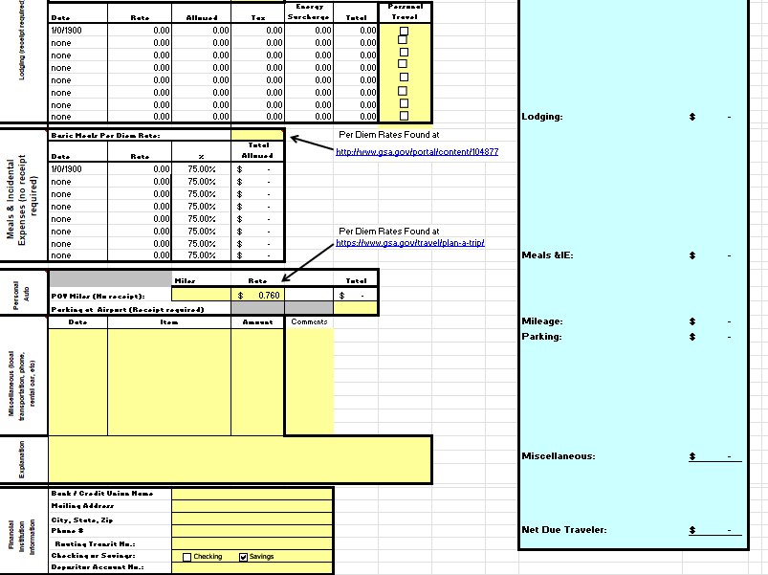
DOELAP Travel Expense Report

Slide 9
Receipts
Ease of Voucher Processing:
  Hotel
  Baggage Fees
  Rental Car
  Gas for Rental Car
  Parking
  Taxis/Uber
  Airport Parking
  Etc.
  CC Snip acceptable for some charges if a receipt is not available

Slide 10
When Travel Goes Wrong
Personal issues
Flights delayed/cancelled
Rental car accident
Other issues?
AdTrav: 888-205-2369

Slide 11
Questions?

